Slide 1
Campus Eats
Rating System
ITCS 3160 Final Project
Katherine Grimes, Casey Oates, Henry Okyere, Di Ta, Matthew Young

Slide 2
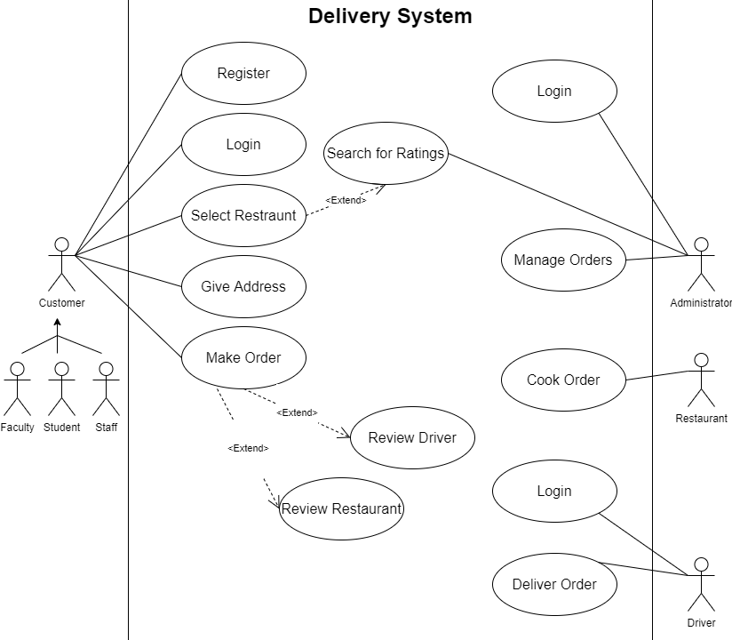
Case
The Campus Eats Delivery System:
Customers can -
Register, Login, Provide Addresses, Select Restaurants to Place Orders & Search/Provide Restaurant Ratings.
Customers can also be a student, faculty, staff, or any combination of the three.
Approved persons can be drivers -
Drivers have a Login and are able to Deliver Orders.
Drivers can have many ratings.
Restaurants can have many ratings and will provide orders.
Administrators can Login to Manage Orders and Search Ratings

Slide 3
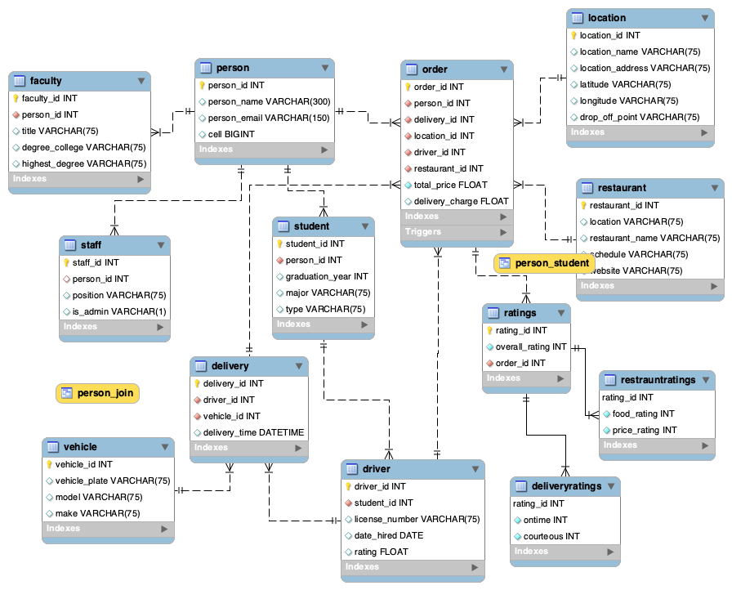
EERD
Notes:
Business Rules:
□ A person must be stored in the system with name, email address and cell number.
o A person can place many orders and leave many ratings.
o They can also be a student, faculty, staff, or any combination of the three.
□ Campus faculty have an account in the system and their title, highest degree and their degree granting institution will be stored.
□ Campus Staff have an account in the system with a staff id, position and if they serve as an Admin.
□ Students have an account in the system with their student id, planned graduation year, major and type of student - graduate or undergraduate.
□ An approved person can also be a driver. Drivers must have a diver id, student id, license number, date of hire and rating.
o Vehicle must be saved with a vehicle id, license plate number, with make and model of vehicle.
o Currently, all delivery personnel are students.
o Drivers can have many ratings.
o Divers can be associated with many orders and deliveries.
□ All deliveries shall have a delivery id, delivery time, with the associated driver and vehicle id’s.
o Deliveries belong to one vehicle and one driver.
□ Any orders must have an order id, total price of the order, with applicable delivery charges and the associated person, delivery id, location id driver id and restaurant.
o Locations which are spots on campus where food can be delivered, with location id, location name, location address, latitude, longitude, and drop-off point - as a brief description.
o Orders can only have an association with one delivery, driver, restaurant and person.
□ Approved restaurants should be given a restaurant id and their location, name operating schedule and website should be stored.
o Restaurants can have many ratings.
□ The ratings must indicate the restaurant, person, driver id, review number, review description and number of stars - based on a 5-star rating system.

Slide 4
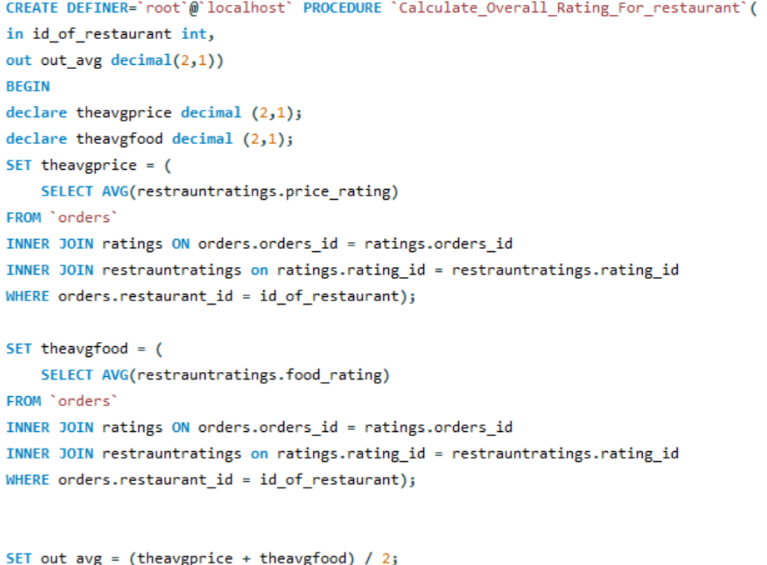
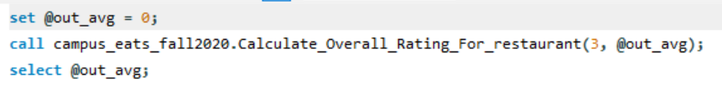
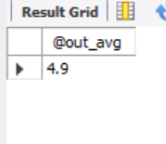

Stored Procedures
Notes:
Stored Procedures use SQL queries to calculate the overall, minimum, and/or maximum of the driver or restaurant rating tables. Which then gives an output for the user. There are six stored procedures that calculate different overalls or extremes for the specific table.

Slide 5
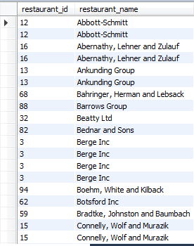
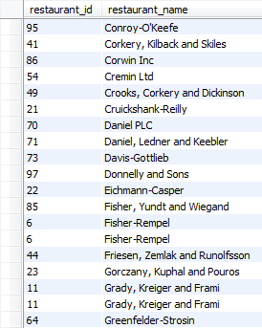
Advance Views

Slide 6
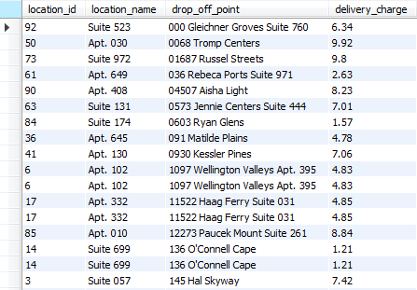
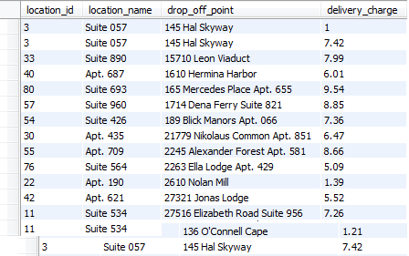
Advance Views(cont.)

Slide 7
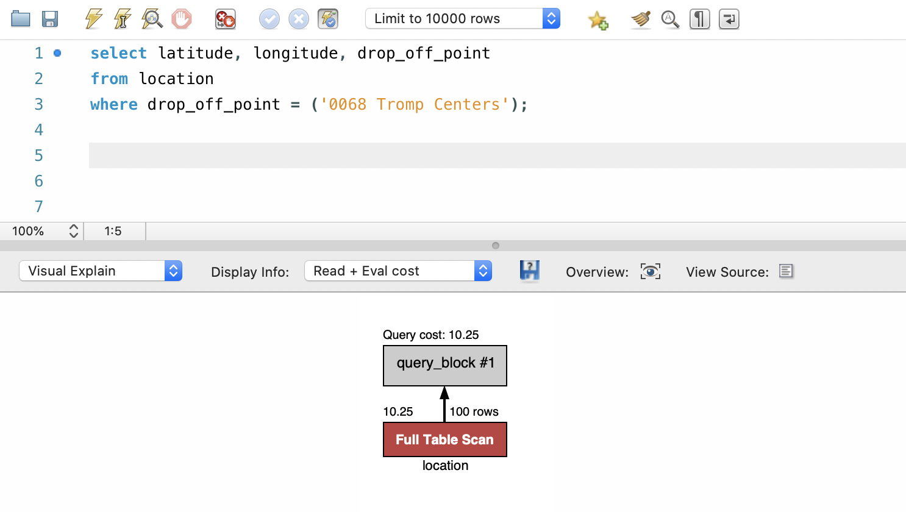
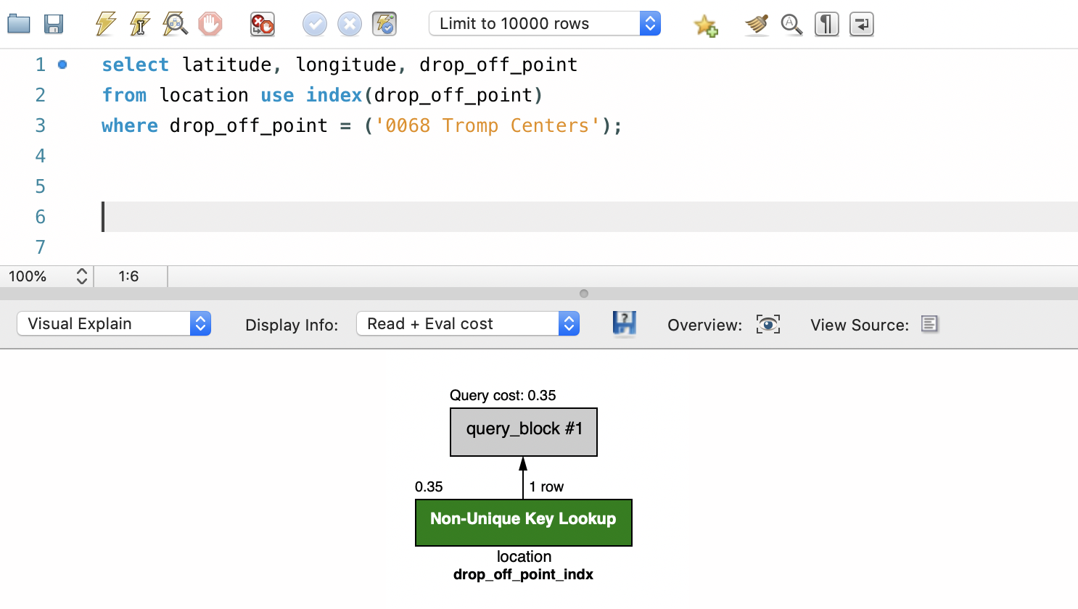
Indexes

Slide 8
Reference
Campus_Eats_Fall2020
created by "mavericks" team:
-- Dhananjay Arora, Akshay Babu, Sumit Kawale, Prashant Madaan
-- this database is only to be used for educational and class
-- purposes and can not be replicated or used for commercial purposes
-- or private interests without permission by the Mavericks team.

